Slide 1
AdisInsight User Guide July 2015

Slide 2
Table of Contents
Registering an account on AdisInsight
Log In
AdisInsight Subscription Access
Basic Search
Advanced Search
Refine Your Search
Viewing a DRUG Profile Record
Viewing a TRIAL Profile Record
Viewing a SAFETY Profile Record
Viewing a DEAL Profile Record
Chemical Structure Search
Exporting Data
Exporting Results (CSV)
Exporting Data Table
Export BizInt
How to use BizInt Charting Tool
Saving Searches
Setting up Email Alerts
How to provide Feedback
Who to contact

Slide 3
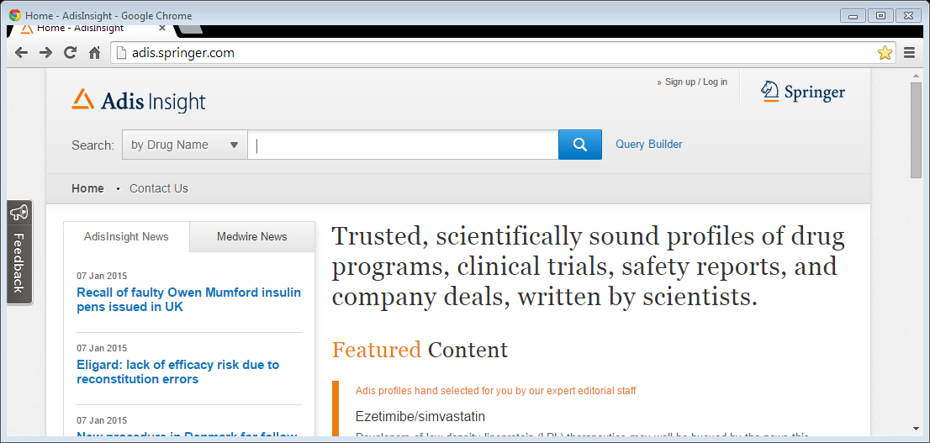
Registering an account on AdisInsight
Creating an account with a username and password allows you to personalize your experience, including setting up saved searches and up email alerts. To register:
Visit http://AdisInsight.Springer.com
Click the “Sign up/Log in” link in the upper right hand corner
Notes:
Registering for an account on AdisInsight

Slide 4
Registering an account on AdisInsight
Complete the form under the heading “Don’t have an account?”
If your institution has IP authenticated access you will be able to access the content straight away.
If you’re not accessing from a registered IP range, your institution’s Administrator will need to associate your account to enable access

Slide 5
Log In
Once you have registered for an account, you can then access the log in screen by clicking on the “Sign up/Log in” link in the upper right hand corner and entering your email address and password
Click the “Forgotten password?” link if you need help

Slide 6
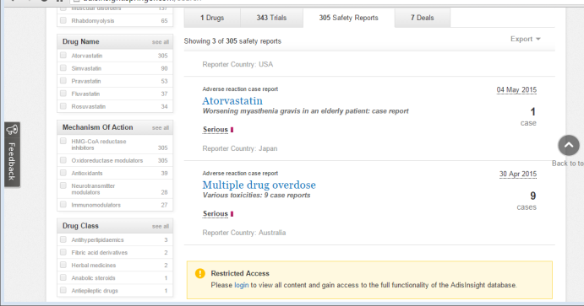
AdisInsight Subscription Access
AdisInsight allows you access to all the content sets to which you subscribe. If you subscribe to all content: DRUGS, TRIALS, SAFETY, DEALS you will be able to seamlessly move from tab to tab
If you only subscribe to one content set (e.g. DRUGS) you will have access to all content for the DRUGS tab, but only a restricted view for the other content sets.

Slide 7
Getting Started: Using ‘Search’ or ‘Advanced Search’
From the home page, begin your quick search by selecting Drug Name, Indication, Mechanism of Action, Drug Class, Adverse Event, OR Full text from the drop down menu and ENTER your SEARCH TERM
OR, to create an advanced query, click the ADVANCED SEARCH link

Slide 8
Basic Search
From the home page, you can immediately begin searching using the quick search options included in the dropdown menu:
Drug Name
Indication
Mechanism
Drug Class
Adverse Event
All Text
Once you have made a selection, start typing your query into the search box
The autosuggest list will offer matching search terms, select from the list or continue typing
Click on the blue search button (magnifying glass) or hit enter to retrieve search results

Slide 9
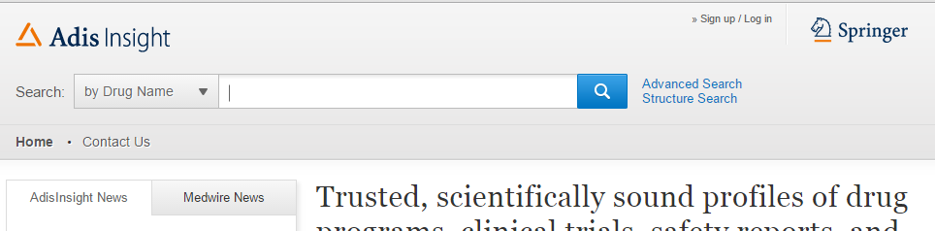
Advanced Search
To conduct an advanced search query, click on ‘Advanced Search’ on the home page
This will bring you to a page allowing you to build a complex query choosing from a wide selection of parameters

Slide 10
Advanced Search
The Advanced Search Query Builder allows you to create a simple or complex search query that returns the most relevant and precise results.
To create your search, start by selecting a search term from ‘Frequently Searched’ or ‘All Search Criteria

Slide 11
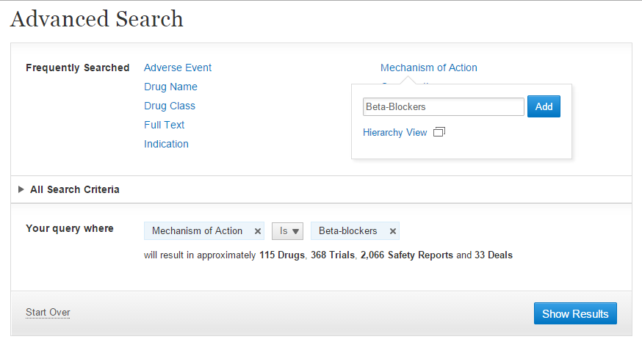
Advanced Search
Once your term is selected, you can see an approximate count for the results you will receive.
You can add as many search terms to your query as you would like clicking “Show Results”
Notes:
Add in more detail here and an example?

Slide 12
Refine Your Search
From the search results page, you can further refine your search using the filters on the left-hand menu.
Filters on the left show you at-a-glance, the top 5 counts for each criteria are shown
You can apply as many filters as you choose OR click the
The added criteria will appear in orange for easy identification
to remove filters

Slide 13
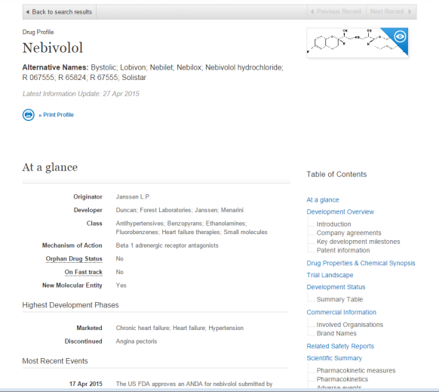
Viewing a Drug Profile Record
From the search results page, you can click the Drug Name to view the full record

Slide 14
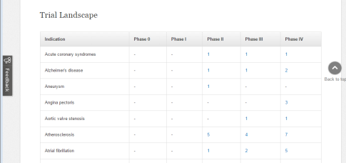
DRUG Profile record includes:
Table of Contents for easy navigation
Drug name and synonyms
Chemical Structure
At a glance section
Development Overview
Drug Properties & Chemical Synopsis
Trial Landscape
Development Status
Commercial Information
Related Safety Reports
Scientific Summary section
Development history table
Reference section

Slide 15
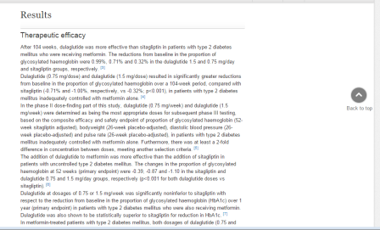
TRIAL Profile record includes:
Table of Contents for easy navigation
At a glance section
Trial Overview
Trial Details
Interventions
Results
Authors
Trial Centres
Trial History Table
Reference section

Slide 16
SAFETY Profile record includes:
Drug Name
Number of cases
Narrative Summary
Author Comments
Country and Language
Descriptors
Related Drugs
Reference Section

Slide 17
DEAL Profile record includes:
Type of Agreement
Date of Agreement
Organizations involved
Drugs/Indications included
Narrative about the deal

Slide 18
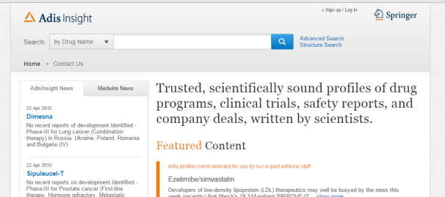
Chemical Structure Search
From the home page, select the ‘STRUCTURE SEARCH’ link found to the right of the search bar

Slide 19
Chemical Structure Search
Begin drawing the chemical structure you would like to find
When you submit, you’ll see the relevant results returned

Slide 20
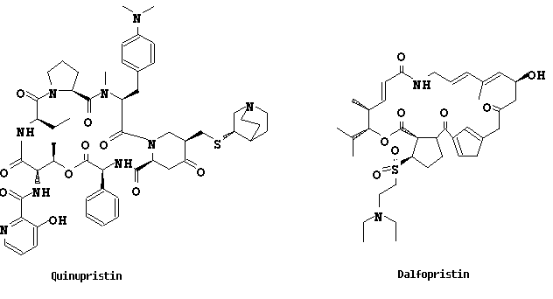
Chemical Structure Search
The relevant results for your Structure search will appear on the results page
Click the drug name to access the profile
The chemical structure is immediately available in the upper right corner of the profile OR the png and mol files are available to download in the DRUG PROPERTIES & CHEMICAL SYNOPSIS section

Slide 21
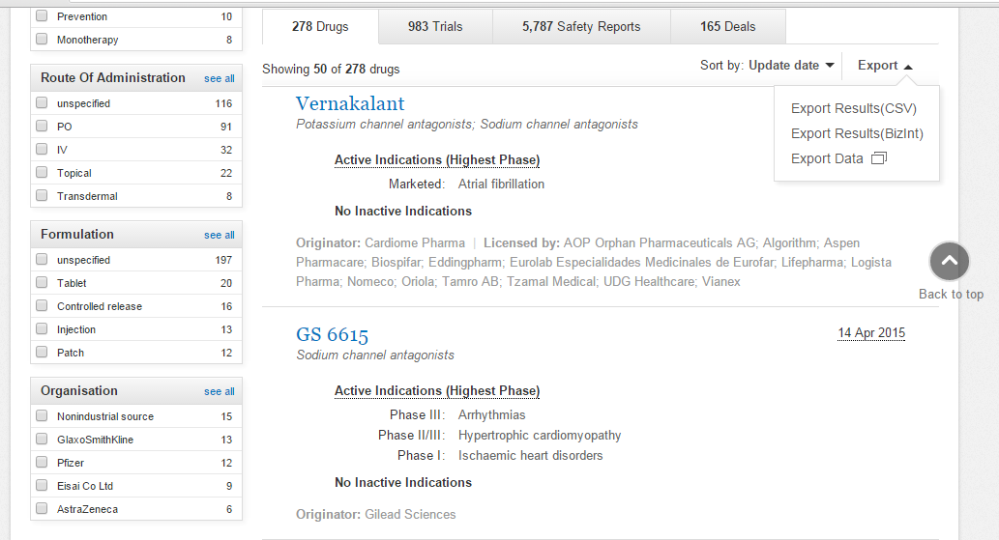
Exporting Data
The next 7 slides illustrate how users can export content from AdisInsight
To export data, select EXPORT in right hand corner and select which format you would like to use

Slide 22
Exporting Data – Exporting Results (CSV)
Select Exporting Results CSV, and you can immediately export the entire results set for a specific tab OR the first 50 selected drugs
Click Options to select which Key drug properties you want to export OR choose to export the detailed development status information

Slide 23
Exporting Data – Exporting Data Table
Select Export Data, and you can choose to create a data table grouped by a single or multiple parameter
Once you click ‘View Results’ you can drill down to view the profiles for a specific parameter OR you can export into a CSV file

Slide 24
Exporting Data – Export BizInt
The BizInt Charting Tool provides report templates users can select from
Select Export Results (BizInt) and choose Export all or selected 50 drugs to BizInt

Slide 25
How to use BizInt Charting Tool
Through AdisInsight, you are able to download and utilize the BizInt Web Charts software to analyze your information. BizIntWeb Charts presents data in tables –also called charts ‐, a format that assists rapid analysis and informed decision-making. You can change the format of a chart, add your own data to it, save and print it. You can also update a chart to incorporate data that has changed since you created the chart.
Download BizInt from Results page
Select Export Results(BizInt)
Select BizInt export options
‘Download BizInt setup’
Select AdisWebCharts.exe file
Follow Install Wizard instructions

Slide 26
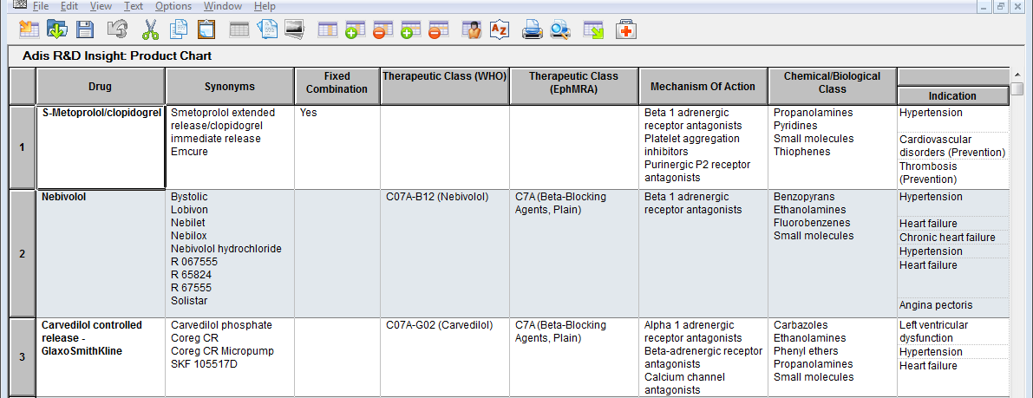
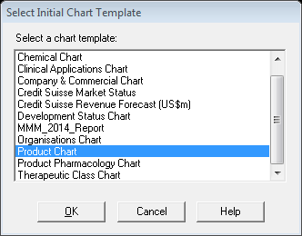
How to use BizInt Charting Tool
Select Export
Select Export all drugs to BizInt
Open file in lower right-hand corner
4. Click ‘OK’ to create a new chart
5. Select a chart template

Slide 27
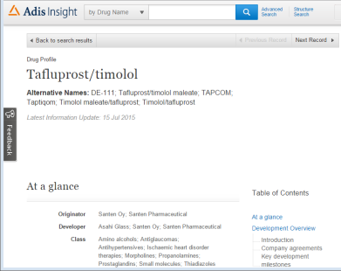
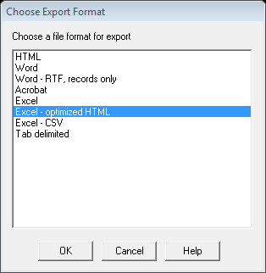
BizInt Charting Tool – Export files
Once you have created a BizInt Chart, you can export the content to any of the file formats shown below
By selecting, Excel – optimized HTML, you are able to share content with colleagues who may not be familiar with, or have access to, AdisInsight
Follow the instructions and name your file, and open the excel spreadsheet
The excel report allows you to share content with colleagues – the Drug name links directly to the most current profile record for that Drug directly on the AdisInsight platform

Slide 28
Saving Searches
Once you have logged in with your User Name and Password (slide 5), you will see the ‘Save & Alert’ button on the search results page
To save a search, select
Access Saved Searches from ‘My Workspace’
and follow instructions

Slide 29
Saving Searches and Setting up Email Alerts
You can set up an email alert to inform you when information has changed for a specific search
On the home page, once you are logged in with your user name and password, you will see ‘My Workspace’
Once you select ‘My Workspace’ you can access Saved Searches and Alerts
You can ‘Run’ saved searches or Create Alerts

Slide 30
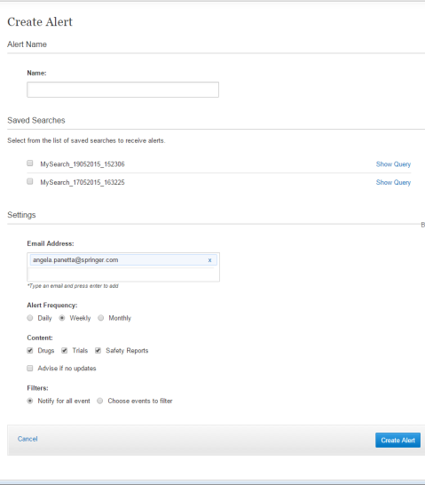
Setting up Email Alerts
To Create an alert from ‘My Workspace:’
Select ‘Alerts’
Create New
Enter a Name for Alert
Select the Saved Search you would like to be alerted for
Add any additional colleague email
Designate Frequency
Deselect ‘Advise if no updates’ if you want to receive an email regardless of whether there are updates included
Select to Save

Slide 31
Setting up Email Alerts
When setting up an Alert, you can apply additional filters to limit the content you receive via your email alert
If you choose to filter events, you are then able to deselect the DRUG FILTERS and Phase change to ensure you only receive notification for those limited events

Slide 32
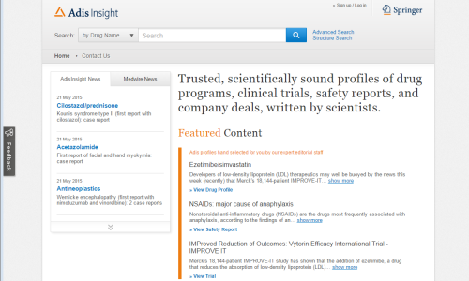
Feedback
If you would like to ask a question or provide feedback, click the Feedback button located on the left-hand side of each page
The Feedback button will open a separate window where you can CONTACT SUPPORT or GIVE FEEDBACK

Slide 33
Questions?
Product: http://AdisInsight.Springer.com
Web: www.springer.com/us/adis
Email: Ask-the-Expert-AdisInsight@springer.com

